Slide 1
Wildfire in Nevada Ecosystems
High School Biology Fire Unit
Lesson 5: Design a Land Management Plan
Notes:
Lesson notes:
The first 20 minutes of this lesson are dedicated to students conducting two Claim Evidence Reasoning statements about how wildfire can increase or decrease ecosystem stability. If your students are slower or have less experience with Claim Evidence Reasoning statements, you can let them choose one of the two and compare with a different group who chose the opposite.
Teacher choice: There are two options for how students can complete this activity. Option 1 is for students to design their land management plan using only the "Land Management Plan Worksheet“ instead of the Excel spreadsheet. This option is easier and takes less time. Option 2 is for students to skip the "Your Solution" table in the "Land Management Plan Worksheet" to design their land management plan using the spreadsheet. This gives students real-time feedback on their resilience score and budget to help them maximize both, but can take more time and requires some familiarity with using spreadsheets.
The remaining part of the lesson is spent on students designing a land management plan to increase the wildfire resilience around Emberville. Most students will not fully complete this challenge during this activity, so plan to spend 10-15 minutes on finishing these up during the next lesson. In the final lesson, students will conduct evaluations of their peers’ land management plans and choose the ones that would have the biggest impact.

Slide 2
Wildfire and ecosystem stability?
Ecosystems are always changing
Gradual changes with high resilience = Stable
Fast changes with low resilience = Unstable and lasting changes
Claim Evidence Reasoning
Complete a C.E.R statement
Notes:
(minutes 4-20) (16 minutes for the whole Claim Evidence Reasoning (CER)
Introduce the CER activity for the included worksheet.
Teacher note: The goal of this activity is that students use the concepts they have learned earlier in this unit to describe how wildfire could increase and/or decrease ecosystem stability. (The short answer is that different types of wildfire and pre fire plant populations can lead to increases or decreases in long-term ecosystem stability). If your students are slow with the CER, you can let them choose one of the two CER’s to complete.
Today we are going to discuss the impact of wildfire on ecosystem stability. Stability is very similar to resilience, which we learned about in Lesson 3. One important concept is that ecosystems are always changing, whether it is increases in one type of plant as another decreases or an increase in plants during a year with more rain. Since Nevada is so dry, plant growth is often limited by the amount of moisture.
Scientists who study ecosystems, ecologists, often refer to periods of gradual change where there is high resilience as stable. Reminder, resilience is the ability to return to the original state after disturbance, while periods of fast change with low resilience are unstable. Times of high instability and low resilience can lead to one type of ecosystem turning to another. For example, the introduction of an invasive species could cause a large and fast change in an ecosystem and change the populations in that ecosystem for a long period of time.

Slide 3
Claim evidence reasoning
Possible sources of evidence
Plant readings
Matchstick model forest fire severity demonstration
Forest carrying capacity graphs
Your answers from challenges 1, 2, and 3 on biodiversity and fire frequency
Data from the field day
Notes:
(minutes 4-20) (16 minutes)
If students need a reminder for how to create a strong Claim Evidence Reasoning (CER) statement, go over that here. You can choose whether students work with partners, individually or in small groups to complete these two CER statements. If your students are slow with the CER, you can let them choose one of the two CER’s to complete.
Students can use these possible sources of evidence to complete CER statement.

Slide 4
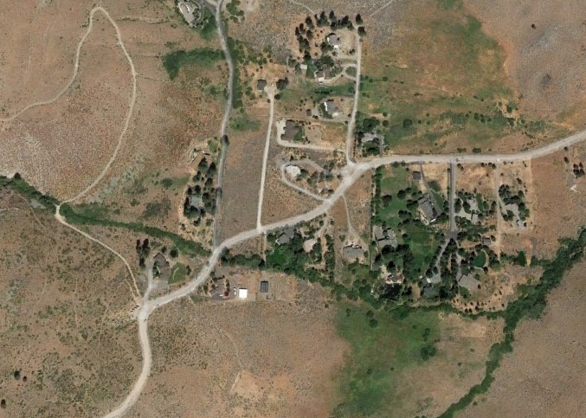
How can we prepare Emberville for wildfire?
Notes:
(minutes 20-22) (2 minutes)
Our final challenge of this wildfire unit is for you to come up with a plan for how to prepare Emberville and the surrounding ecosystems to be more resilient to wildfire. In this challenge you will use what you have learned about wildfire and ecosystems in Nevada to create a proposal for specific actions that could be done around Emberville to prepare it for a possible wildfire.
Ask students to brainstorm possible actions that could be taken around Emberville to increase its resilience to wildfire.
The goal for the rest of this lesson is for students to complete as much of this activity as possible. They will have time during the next lesson to finish anything they didn’t get to today before conducting the peer evaluations of each others projects.
Optional video: This 2.5-minute BLM video describes a similar fuels management project,t https://www.youtube.com/watch?v=jnNTVyy9-As.

Slide 5
Land management actions
Chainsaw crew
Mowing and mastication
Herbicide and grazing of cheatgrass
Planting competing plants
Prescribed fire
Notes:
(minutes 22-23) (1 minute)
Compare this list to student answers. Make connections between students suggestions and these options where applicable.
These are the five most common actions land managers have to increase the resilience of an area to wildfire. Each one of these comes with different costs and has different impacts on an area.
Next we will give a brief overview of these five treatments you can choose to apply around Emberville to prepare it for wildfire.

Slide 6
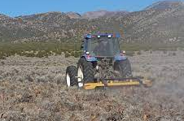
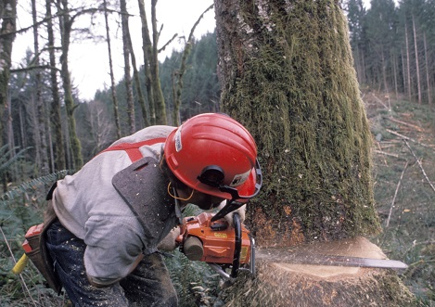
Tree and plant removal
Mowing and mastication
Chainsaw crew
Fast, on flatter ground
Mow shrubs and grasses
Masticate trees and shrubs
Slower
More precise
Can go on steeper hills
Notes:
(minutes 23-25) (2 minutes)
The main options for removing trees and plants are mowing, mastication and chainsaws.
Mowing is like a large lawnmower often behind a tractor. Masticators are an attachment on the front of heavy machinery that can grind trees and shrubs into small chips. Mowing is best for shrubs and grasses and can’t remove trees. These large machines are faster on flat ground but can’t go on steeper slopes. Mowing often cuts everything in the mowers path, from shrubs to perennial grasses and annual grasses, leaving an empty path behind it. Here is a 1:44-minute video from the BLM on mastication. The first minute is the most relevant, https://www.youtube.com/watch?v=UCx_oX1WdqA.
Chainsaws work on trees and some large shrubs. While they are slower than the larger machines, they have two main advantages: they can go on steeper ground and can be more precise. They can remove only some types of plants or trees based on specific recommendations.

Slide 7
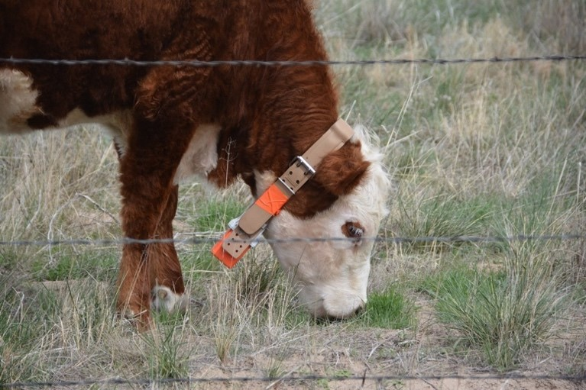
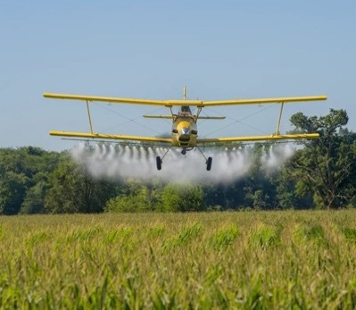
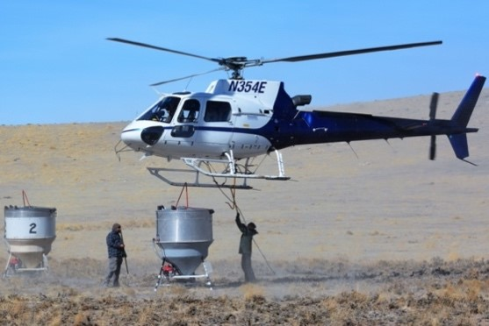
Invasive species management
Herbicide and grazing
Planting competing plants
Specific times of the year
Grazing requires fencing
Can’t be used near water
Compete with cheatgrass
Done by hand or plane
Perennial grasses mostly
Notes:
(minutes 25-27) (2 minutes)
In order to manage invasive species (cheatgrass), we have two main options.
We can remove the invasive species with herbicide, a chemical that poisons a specific type of plant, or have animals eat that type of plant. Both of these need to be done at specific times of the year to be effective.
Grazing to reduce cheatgrass only works during the winter/early spring when the cheatgrass is green and edible to animals. The herbicides for cheatgrass need to be applied to an area in the fall before they cheatgrass seeds sprout in order to work.
Another option is to plant plants, mostly perennial grasses, that can compete with cheatgrass. This can be done by hand or by plane. It often takes 20% cover of perennial grasses or more to compete with cheatgrass. If there are very few sagebrush or trees in an area where those populations should be higher, sometimes seedlings of those plants are planted by hand.

Slide 8
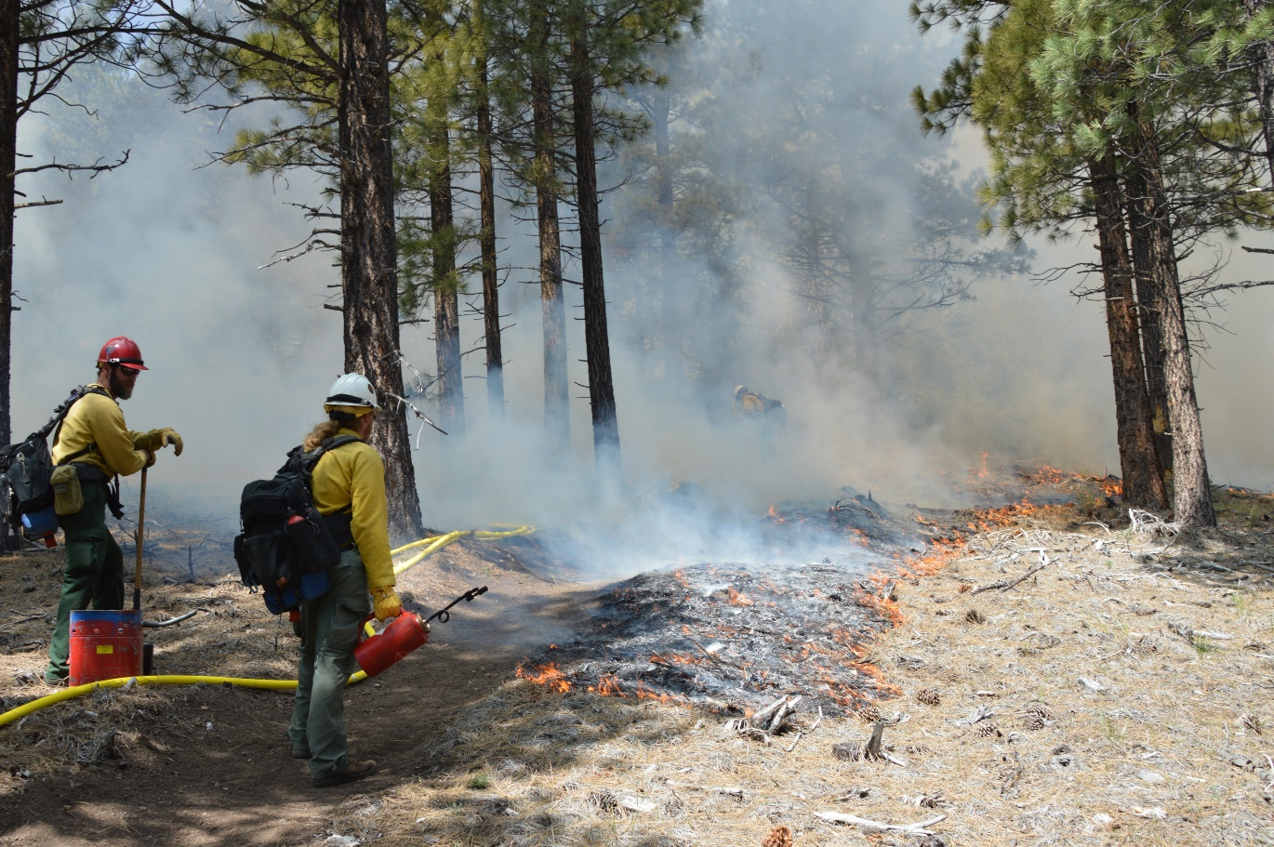
Prescribed fire
Controlled low severity fires
Mostly burn shrubs, grasses, and dead material on the ground, and small trees
BLM firefighters start a prescribed fire to improve forest health. BLM photo.
Notes:
(minutes 27-29) (2 minutes)
Sometimes firefighters will use fire to clean an area of living and dead plant material. This is call prescribed fire.
Prescribed fire can be done in many different ways, depending on the intended goal, but is often done to remove the dead and living fuels close to the ground. Prescribed fire is very effective at reducing the amount of fuel in an area, making it better prepared for a future wildfire. In order to conduct prescribed fire safely, the fire needs to be done in the right weather conditions (e.g. cool and not windy days). Sometimes it is also necessary to do some chainsaw thinning or mastication before doing a prescribed fire so that the prescribe fire burns the intended plants, not too many or too few.
Here is a 2.5-minute BLM video about one type of prescribed fire called pile burns, https://www.youtube.com/watch?v=ytfhUab4V4E. Note there are two types of prescribed fire, pile burns, which are the most common, and broadcast burns, shown in the photo above. Broadcast burns are harder to execute but are more beneficial to the area.

Slide 9
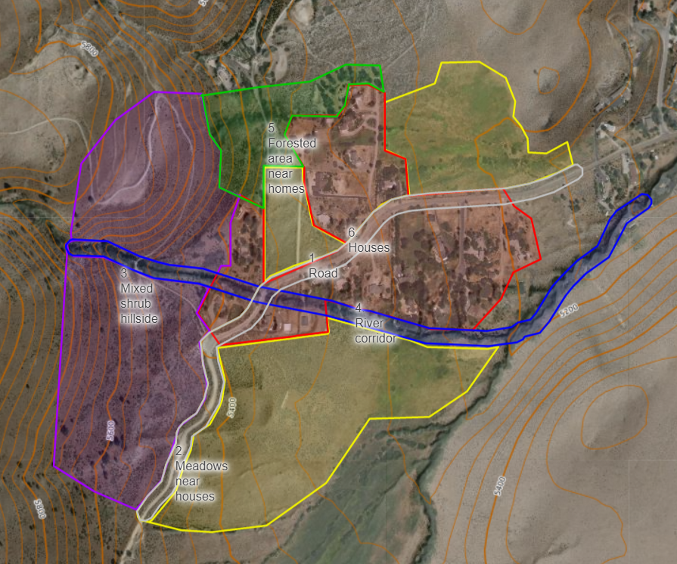
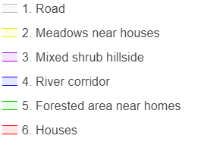
Map of area of management
Notes:
(minutes 29-31) (2 minutes)
Here is a map of Emberville divided up into several areas. Your job will be to choose which treatments would be helpful in different areas. Just like professional land managers, you won’t have enough money to do every treatment on every area so you will have to pick the treatments and areas that will have the greatest impact on improving wildfire resilience.
Show students this map of Emberville.
Open the map on this link https://caltopo.com/m/1V52S and you will go to a map of your 140-acre parcel.
Explore each of the numbered polygons by clicking on them. Look at the acre size and read about their ecosystem composition on the handout.

Slide 10
Area of management
Type of plant | Road | Meadow | Mixed shrub | River | Forested area | Houses | Type of plant
Annuals | 26% | 33% | 24% | 6% | 9% | 7% | Annuals
Perennials | 14% | 31% | 12% | 19% | 11% | 6% | Perennials
Shrubs | 22% | 12% | 22% | 9% | 12% | 10% | Shrubs
Trees | 5% | 4% | 5% | 11% | 34% | 7% | Trees
Bare ground | 11% | 4% | 12% | 5% | 3% | 19% | Bare ground
# of acres | 9 | 24 | 48 | 10 | 10 | 6 | # of acres
Notes:
(minutes 31-33) (2 minutes)
Introduce this table that shows the percent cover of each area to students. Make connections between this percent cover data and the percent cover data studied in Lessons 2 and the field day, if you did the quadrat surveys.
Have students form into groups, pairs or individuals depending on how you set up this final project. Then have them read through the descriptions of each area and look at this table.
Groups should complete the initial review sheet where they describe any resilience problems in that area and suggest possible solutions.

Slide 11
Area | Problem(s) | Soervice(s)
Road
Meadow
Mixed shrub
River
Forested area
Houses
Notes:
(minutes 33 to end of class for the remaining three slides through “Budget and resilience score”.)
Show this table as it fits with students progress through the student worksheet.
There are a lot of different options of services and different areas to do those services in. Use this table to start planning how you can help protect Emberville.
For each area, read the description of that area and look at the percent cover table to identify possible problems. A problem could be having too many of one population, too many invasive species (annual grasses are mostly invasive species in Nevada), or burnable materials near homes. In the service solutions column list, which of the five services could help solve that problem?
The under the solution service column, write which of the five services would be helpful in addressing this problem. You may want to do more than one service in an area or find that some areas are healthy and don’t need services done to them.

Slide 12
Area | Treatment | Cost
Road | Herbicide and grazing | $315
Road | Prescribed fire | $1,575
River | Mowing and mastication | $2,750
Houses | Planting plants | $18,900
Total cost Must be less than $30,000 |  | $23,540
Notes:
(minutes 33 to end of class for the remaining three slides through “Budget and resilience score”.)
Just like the land management professionals, you don’t have enough money to do everything you planned above and will have to pick the services that will be the most helpful. Pick the treatments and areas that you think will have the biggest impact on improving Emberville’s wildfire resilience. Make sure your total cost is less than $30,000. You can choose to pay for more than one service in one area and no services in other areas if you think that would be the most helpful.
If you are paying for multiple services in the same area, like the road on this example, just give each service a row. At the bottom you can calculate the total cost using the cost per treatment in different areas table in your handout.

Slide 13
Budget and resilience score
Budget |  | Treatment | Road | Meadow | Mixed shrub | River corridor | Forested area | Houses
Plot | Acres | Chainsaw crew
Road | 9 | Mowing and mastication | Enter “1” in the cells for the actions you plan to do. Your budget and resilience score will be calculated below.
Meadow | 24 | Herbicide and grazing
Mixed shrub | 48 | Planting plants
River corridor | 10 | Prescribed fire
Forested area | 10
Houses | 42 | Treatment | Road | Meadow | Mixed shrub | River corridor | Forested area | Houses
Treatment | Cost / acre | Chainsaw crew | $ - | $ - | $ - | $ - | $ - | $ -
Chainsaw crew | $ 100 | Mowing and mastication | $ - | $ - | $ - | $ - | $ - | $ -
Mowing and mastication | $ 275 | Herbicide and grazing | $ - | $ - | $ - | $ - | $ - | $ -
Herbicide and grazing | $ 35 | Planting plants | $ - | $ - | $ - | $ - | $ - | $ -
Planting plants | $ 250 | Prescribed fire | $ - | $ - | $ - | $ - | $ - | $ -
Prescribed fire | $ 175 |  |  |  |  | Total cost |  | $ -
 |  |  | Resilience score |  | 0 | Total budget |  | $ 30,000
Notes:
(minutes 33 to end of class for the remaining three slides through “Budget and resilience score”.)
Students can either use this spreadsheet, which will automatically calculate their budget and resilience score, or do a fully paper version of this activity by using the included resilience score handout. (This handout is functionally the answers to their land management plan, so make sure to hand this out after students have finalized their plans)
In this spreadsheet you will be able to calculate your budget and your resilience score. The resilience score provides the answers for what a professional land manager would do to increase the wildfire resilience around Emberville.
You only need to make changes to the yellow part of this spreadsheet. Enter a “1” in the cell that matches with the treatment and area you want to do. For example, the top left yellow corner would mean sending a chainsaw crew to the road.
The bottom “Total cost” cell shows the cost for each treatment. That will automatically calculate once you start adding “1”s into the yellow cells. You will also see a “Resilience score” box. That number will go up or down based on the actions you choose. Your goal is to have a resilience score of 20 or higher while staying under budget.

Slide 14
Budget and resilience score
Treatment | Road | Meadow | Mixed shrub hillside | River corridor | Forested area | Houses
Chainsaw crew | 3 | 1 | 4 | 4 | 10 | 7
Mowing and mastication | 10 | 6 | 5 | -1 | 6 | 2
Herbicide and grazing | 3 | 7 | 7 | -10 | 2 | 3
Planting plants | 3 | 5 | 2 | 0 | 2 | 5
Prescribed fire | 1 | 4 | 3 | 3 | 8 | 1
Notes:
Students can either use this spreadsheet which will automatically calculate their budget and resilience score, or do the paper version of this activity by using the included resilience score handout. (This handout is functionally the answers to their land management plan, so make sure to hand this out after students have finalized their plans)
This slide is hidden, so only show it after students have completed their proposed land management project.
This handout shows the resilience score for any service in any area. Students should find the actions they took in each area and add up their total resilience score.

Slide 15
Peer evaluations
What parts of their plan would be the most helpful at increasing the wildfire resilience around Emberville?
What is one area their plan could be improved?
What could be improved or you would have done differently? How will it maintain healthy population sizes?
Notes:
Teacher note: This or earlier is the likely stopping point for Lesson 5 with the remaining slides finished on Lesson 6 when students evaluate peer solutions.
Tomorrow you are going to evaluate each other’s proposals for Emberville. Just like land managers who have many projects and limited funds, you are going to have to choose which proposals are worth spending money on.
Your job will be to read through another group’s proposal and answer these three questions about it. If time allows, you will read through a second group’s proposal and choose one of the two to fund.

Slide 16
Reflection questions
Complete these short questions about why you picked the services and areas you did
Peer evaluation tomorrow will be based on your selections, resilience score and justification
Notes:
Today or tomorrow, have students complete the recap question in the student worksheet that asked them to justify why they selected the services and areas they did. Remind them that during the peer evaluation they will have their project evaluated by their peers based on the services they selected for different areas, their resilience score and their justification.

Slide 17
Reflection questions 2
Describe two of the most important actions in your plan and their impact
If you chose multiple actions in an area, why did you choose those actions that area?
Describe how one of your actions will increase the biodiversity around Emberville
Describe how one of your actions will help maintain a healthy plant population size around Emberville
Notes:
Have students complete these reflection questions about the services and areas they picked.

Slide 18
Areas for improvement | Proficient | Examples of exceeding standards
 | Completes CERs that effectively use evidence sources in this unit to make a thoughtful and logical argument
 | Completes a land management plan demonstrating what they have learned in this unit to justify the choices made about how to increase wildfire resilience around Emberville
Notes:
Lesson 3 Single-point rubric

